Slide 1
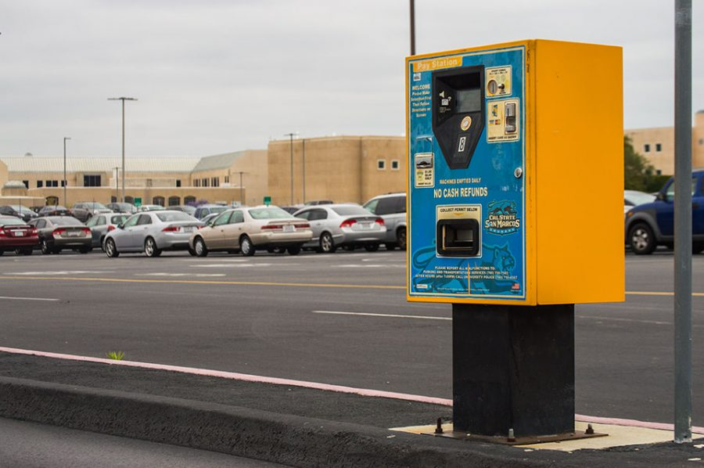

Campus Parking Management System
Proposal by:
Kevin Truebe
Chris Banci
CIS 341
May 15, 2017

Slide 2

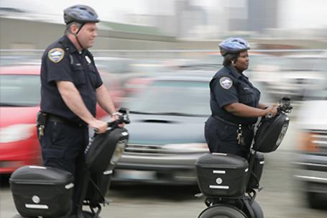
Overview: Current System
Hosted on an outdated cloud vendor.
No option to pay for parking automatically.
No way to view available parking around campus.
No way to enforce parking automatically
Notes:
So essentially the current system is outdated and in reponse this, the new director of parking services is requesting an improved system that will integrate with the existing system.
So here is an overview of our current:
Firstly, it is being hosted on a cloud vendor that is not taking advantage of innovative solutions.
Secondly, it does not provide an option to pay for parking automatically.
Thirdly, it does not provide a way for parking enforcement to automatically recognize license plates
And lastly, it does not provide a way for students to view available parking around campus.
By identifying the issues in the current system, we have established a set of new features that will be of great benefit.

Slide 3
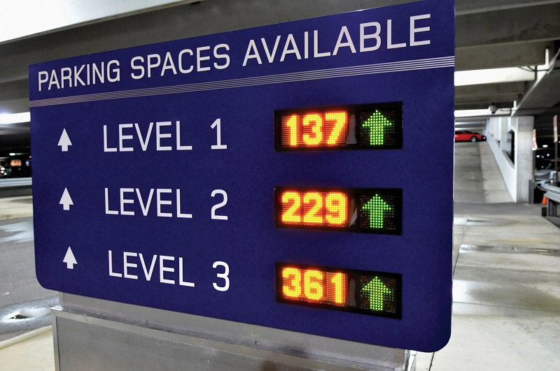
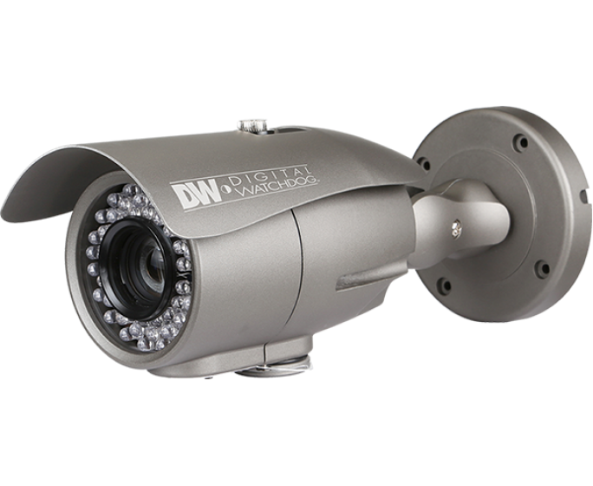


Overview: Proposed System
Amazon Web Services (AWS)
Automated Parking Payment Solution with RFID
Available Parking Solution
License Plate Recognition (LPR) Technology
Notes:
Our proposed system will include the following:
The use of amazon web services as they provide the necessary computing power, database storage, and innovative functionalities.
An automated parking payment solution through the use of RFID tags. In this, the student can either pay as they go, or prepaid.
An availsble parking system which will help students find available parking through live displays and through a mobile interface.
The use of License plate recognition technology to assist in security and issuance of parking citations automatically.

Slide 4
System Planning: Business Process
Process | Objective | Input | Output | Tasks | Outcomes
Vehicle management process | To maintain a database of all students that park on campus | Vehicle information of student | Ability to access vehicle information within the system. | Add vehicle information to database | Complete and accurate information of all vehicles parked on campus used for parking enforcement.
Automated Parking Payment Process | To process credit card information for automated parking payment | Request for parking. Credit card information. | Parking time is received | Issue RFID tags to students. | Time and convenience is saved when paying for parking.
Vendor Migration Process | To migrate to a vendor that is up to date with technology | Data from current system | System has new data | Migrate old data to new vendor | Campus parking uses innovative technology
Notes:
Here are three examples of processes that are crucial to run the system.
So we have vehicle management process where the objective is to maintain a database of all students parking on campus
The next process relates to the automated parking payment where the objective is to process credit card information
The last process on the list is the migration process of switching to amazon webservices.

Slide 5
System Planning: Use case
Name of Use Case | Parking Validation Process for Pre-loaded tags
Actor | Student
Successful Completion | Student has already preloaded their tag. Student passes through RFID sensor System verifies the tags on the car. System does not need to track this car after check-in.
Alternative | Student does not have preloaded tags System notifies Parking Enforcement
Precondition | Student has agreed online to pay via tags and has received tags in mail. Student has already pre-loaded their parking account with funds.
Post condition | Amount is deducted from preloaded account upon leaving campus.
Assumptions | None
Notes:
Here is one of our use cases which expains the validation process for parking when a student has preloaded their rfid tag with money.

Slide 6
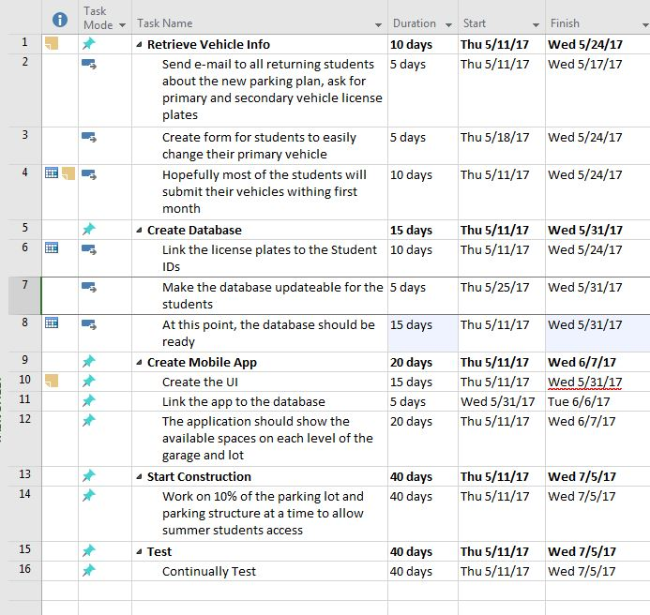
System Planning: Project Plan
Notes:
Here is our project plan.
We propose that the project should start during the summer when students are not on campus.
Its estimated that it will take 7 weeks to implement the improved parking management system.
First task is to retrieve vehicle info of each student. This is done by emailing all returning students.
Second task is to create the new database and will be using an relational database hosted on amazon web services.
Third task is the create the mobile app so students can view available parking around campus and manage parking payments.
Fourth task is to start construction of the new improved parking system.
And last task is to continually test it until everything is working as it should.

Slide 7
System Analysis: System Requirements
System Features | Priority | Current Custom Solution | Requirements
Camera System | High | None | The camera should identify license plates of vehicles.
Backup Tag system | Normal | None | The backup tag system should provide students with a temporary pass.
Available parking display | Medium | None | Displays across campus should display available parking in a specific parking lot.
Phone Interface | Normal | None | The phone interface should incorporate a way to manage parking payments and view available parking across campus.
Automated parking payments | High | None | The RFID tag should provide automatically purchase parking time.
Vendor Migration | High | Outdated | The new vendor should be keeping with new innovations.
Notes:
Here are our system requirements:
So we have the Camera system, Backup Tags for visitors and other circumstances, displays at the entrances for available parking as well as on the phone application, the ability to automate parking payments and migration to Amazon Web Services.
The goal is to have all of these features implemented before the fall session begins, but most importantly we would need to have the camera system, automated parking payments and the vendor migration done before then.

Slide 8
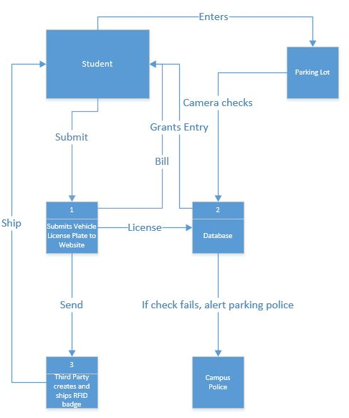
System Analysis: Data Flow
Notes:
This is our data flow diagram, in the diagram
The student will submit their primary and alternate vehicle to CSUSM to be entered into the database
The License will be entered into the datasebe and a third party will create and ship the RFID badge to the student
The student may then choose to preload, pay as you go, or pay for the full semester outright with their credit card
Now, once the student enters the parking lot, the RFID will check them in, if they have no RFID, the camera system will detect the licence plate, take a picture, and alert campus police.

Slide 9
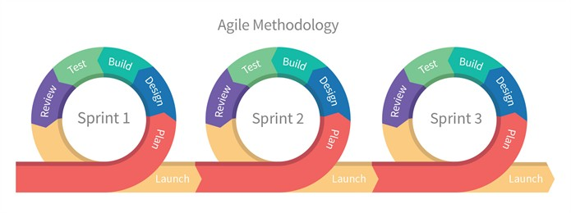
System Design: Development process
Agile Process
Focus on the student
Using a team-based approach with time and efficiency in mind
Manage the team with scrums
Notes:
For project management, we will be using the agile process. We believe that using this team based approach will help us complete the project on time and efficiently. Using the agile process, we can make sure that there is a working model by the time students return for the fall semester, even with setbacks. With this process, the focus is based on the student, or our customer, meaning we will create a better product for our users.
We will manage a team of developers with daily scrum meetings. These meetings will help our team stay in sync, build trust, maintain visibility of the project for all members of the group and help make corrections for the sprint. These meetings will help our team stay focused and understand each other’s work as well as help clear roadblocks that are looming ahead for each team member.

Slide 10
System Design: Method Design
Pre-paid Method() If Student has pre-paid account and Their vehicle is already in the database Access is granted Else Charge Credit Card
Pay as you go Method() If Student has pay as you go account and Their vehicle is already in the database Charge credit card Else Notify Campus Police
Display Update Method() If vehicle goes over parking sensor Decrement available parking count Update display
Notes:
These are a few of the method designs that we used.
So, for example, if the student has a pay as you go RFID tag, the vehicle would be already in the database and would in turn charge the credit card when the student leaves the lot or structure.
If the student’s vehicle is not in the database, campus police will be notified via the new camera system.

Slide 11
System Design: Test Plan
Step | Navigation | Passed | If Test didn’t pass, why? | Test Description
1 | Camera system | Y | N/A | Test a car to see if the camera system alerts campus police
2 | Parking Structure | Y | N/A | Test if the structure detects correct amount of cars
3 | Parking Lot | Y | N/A | Test if the Parking Lot is detecting the correct amount of cars
4 | Mobile App | Y | N/A | Test if the app is refreshing the correct available parking spots
5 | Amazon Web Services | Y | N/A | Test to make sure all data is uploading to Amazon
Notes:
Here is a sample test plan for the System Design.
We can test a sample car to see if the camera system and check if it alerts campus police.
We will also test the parking structure and lot to make sure it is incrementing and decrementing the display counter correctly and that the mobile app is refreshing accordingly.
Lastly, test Amazon Web Services to make sure all data is correctly uploading.

Slide 12
Summary
In short, we are trying to create a more efficient system for parking on campus.
This system will give more control and information to students and staff.
For students who do not wish to pay prematurely for a pass, they have a much better option for parking. While students who already benefit from a prepaid pass, they now have the ability to enjoy a mobile app that can help them find a parking space.
The new camera system will help make the campus a safer place.
Lastly, for campus parking police, they now have a easier way to track and process violations.

